Slide 1
Hadoop Commands

Slide 2
Hadoop Commands
$vi file.txt
Press insert, Write something in the file
Esc : WQ to exit
$hadoop fs -mkdir ram
$hadoop fs -put <source> <destination>
$hadoop fs -put file.txt ram/file.txt
$hadoop fs -ls
$hadoop fs -ls ram

Slide 3
Hadoop Commands
$hadoop fs -get <source_in_hdfs> <destination_in_local_file_system>
//Copies to local file system
hadoop fs -get ram/file.txt new_file.txt
$hadoop fs -copyToLocal <source_in_hdfs> <destination_in_local>
hadoop fs -copyToLocal ram/file.txt new_new_file.txt
$hadoop fs -cat <file_name>
//show contents of file in hdfs
hadoop fs -cat ram/file.txt

Slide 4
Hadoop Commands
$hadoop fs -rm <file_name>
>> deletes a file from hdfs
$hadoop fs – mkdir gsam
$hadoop fs -put file.txt gsam/file.txt
$hadoop fs – rm ram/file.txt
$hadoop fs -rmr <directory_name>
hadoop fs – rmr gsam

Slide 5
Hadoop Commands
$hadoop fs -cp <fileName_with_source_in_hdfs_> <destination_directory>
>> Copies one or more files from a specified source to a specified destination. If you specify multiple sources, the specified destination must be a directory.
Example:
hadoop fs -mv ram/file.txt gsam

Slide 6
To Run Map Reduce Jobs
$hadoop jar <jar_containing_java_class_files_of_driver_mapper_recucer.jar> <driver_class_name> <input_file_with_location_of_hdfs> <output_directory>
***will be covered during map reduce class

Slide 7
Hadoop Commands
>> Displays the size of the specified file, or the sizes of files and directories
that are contained in the specified directory. Usage:
hadoop fs -du </directory/file>
Example:
hadoop fs -du /ram/file.txt

Slide 8
Hadoop Commands
$hadoop fs –help
-to get help
$hadoop fs –expunge
To empty the trash
hadoop fs -tail ram/file.txt
To view last few lines of the file.txt

Slide 9
Hadoop Commands
hadoop dfsadmin –report
>> Used for finding total usage on a cluster
count:Counts the number of directories, files, and bytes under the paths that match the specified file pattern.
Usage:hdfs dfs -count <path>
Example: hdfs dfs -count ram
hadoop fs –count ram

Slide 10
Hadoop Administration Commands
balancer:Runs the cluster-balancing utility. The specified threshold value, which represents a percentage of disk capacity used. It is used to overwrite the default threshold value (10 percent). To stop the rebalancing process, press
Ctrl+C.
Syntax:hadoop balancer [-threshold <threshold>]
Example:hadoop balancer -threshold 10

Slide 11
Hadoop Administration Commands
hadoop version
-To get the version of hadoop

Slide 12
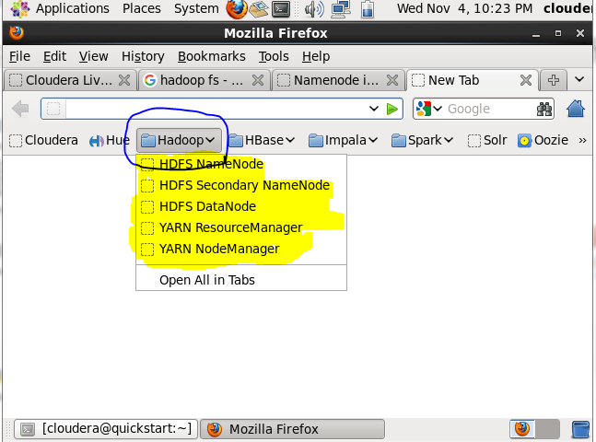
Using Hadoop from Browser

Slide 13
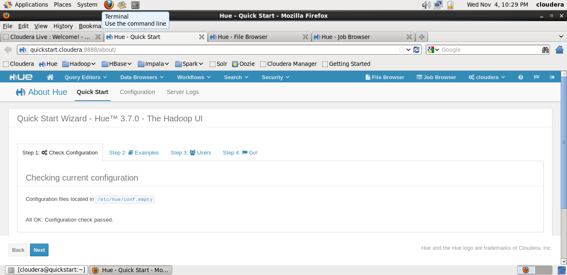
Using Hue

Slide 14
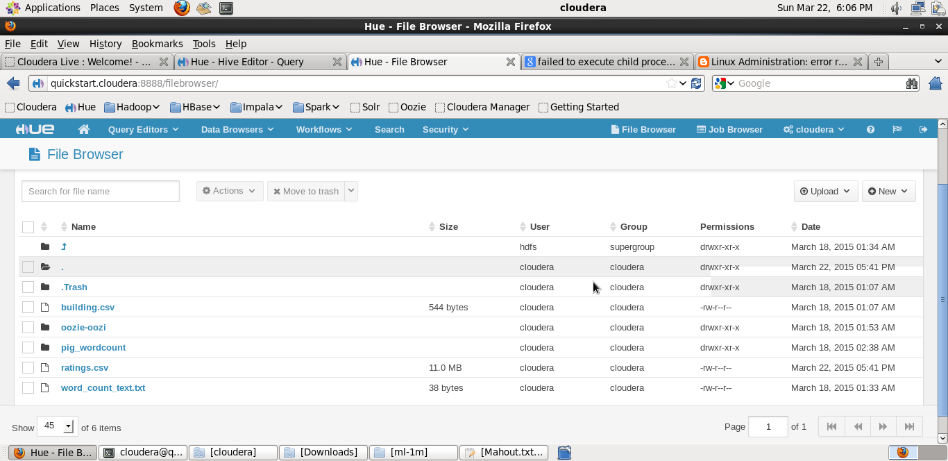
File Browser

Slide 15
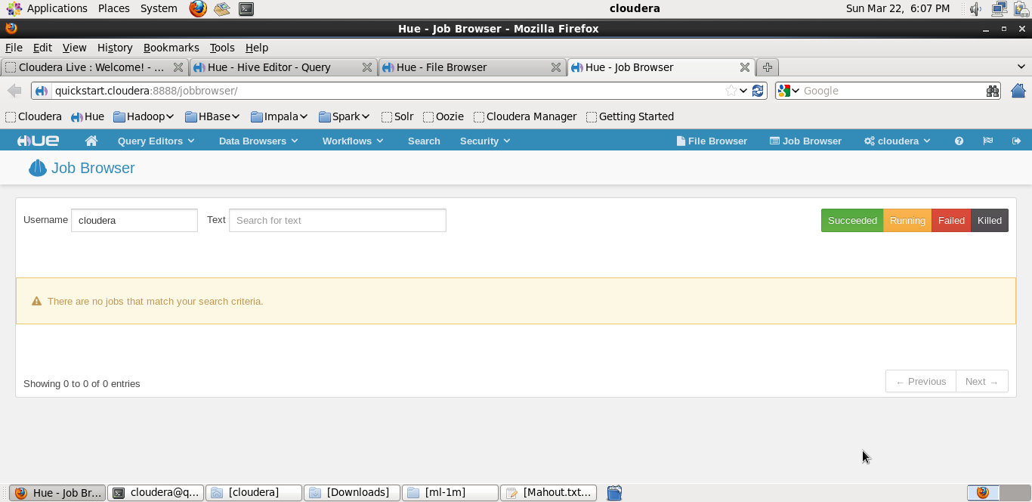
Job Browser

Slide 16
Thank You!

